Slide 1



Submitted by:
Aayusha Regmi, 201502
Abhinab Khanal, 201503
Raaz Gupta, 201545
Sandesh Khatiwada, 201547
- A Web-based Freelancing Platform
A Mid-Term Presentation by Team APParatus
Notes:
Insert suitable picture, representing your thesis work in the place of Photo

Slide 2
INTRODUCTION
1. Project Name: RojgarNepal
2. Aim: Revolutionize freelancing in Nepal
3. Purpose: Address challenges for service providers and Job seekers
4. Key Feature: User-friendly platform offering diverse services
A Mid-Term Presentation by Team APParatus
1

Slide 3
STATEMENT OF PROBLEMS
Challenges in Freelance Market:
Difficulty in accessing suitable freelance opportunities
Inefficiencies in traditional job search methods
Urban Demand:
High demand in cities like Kathmandu, Pokhara, and Biratnagar.
Limited platforms for specific local jobs like carpentry and cleaning.
A Mid-Term Presentation by Team APParatus
2

Slide 4
OBJECTIVE
To develop an inclusive web application that caters to the requirements of Nepali freelance landscape.
To facilitate direct communication between freelancers and clients.
To facilitate the payment process, through an integrated online payment system.
A Mid-Term Presentation by Team APParatus
3

Slide 5
LITERATURE REVIEW
Guru.com : Lacks certain local job categories.
Sriyog.com: Complex registration, no recommendation system.
Upwork.com: Focuses on high-skill jobs, not suitable for local low-skill
jobs.
Our Solution: Incorporates low-skill jobs, easy registration,
recommendation system
A Mid-Term Presentation by Team APParatus
4

Slide 6
PROPOSED DELIVERABLES
Effortless job announcements and bookings.
Integrated chat system for communication.
Secure Online Payment Integration.
Recommendation System
Client rating system for trust.
Flexible, responsive web app.
A Mid-Term Presentation by Team APParatus
5

Slide 7
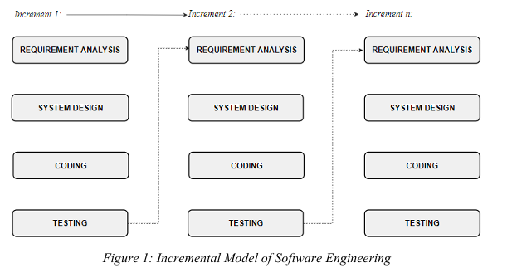
METHODOLOGY
The incremental model suits our project well as it allows for continuous feedback integration, ensuring that each iteration enhances the system's functionality and addresses evolving user needs effectively.
A Mid-Term Presentation by Team APParatus
6

Slide 8
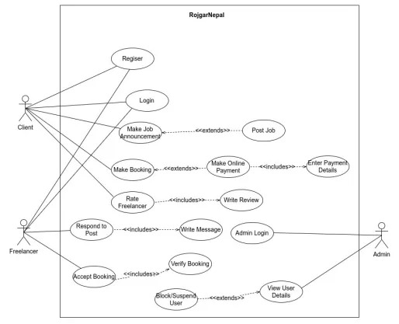
USE CASE DIAGRAM
A Mid-Term Presentation by Team APParatus
7

Slide 9
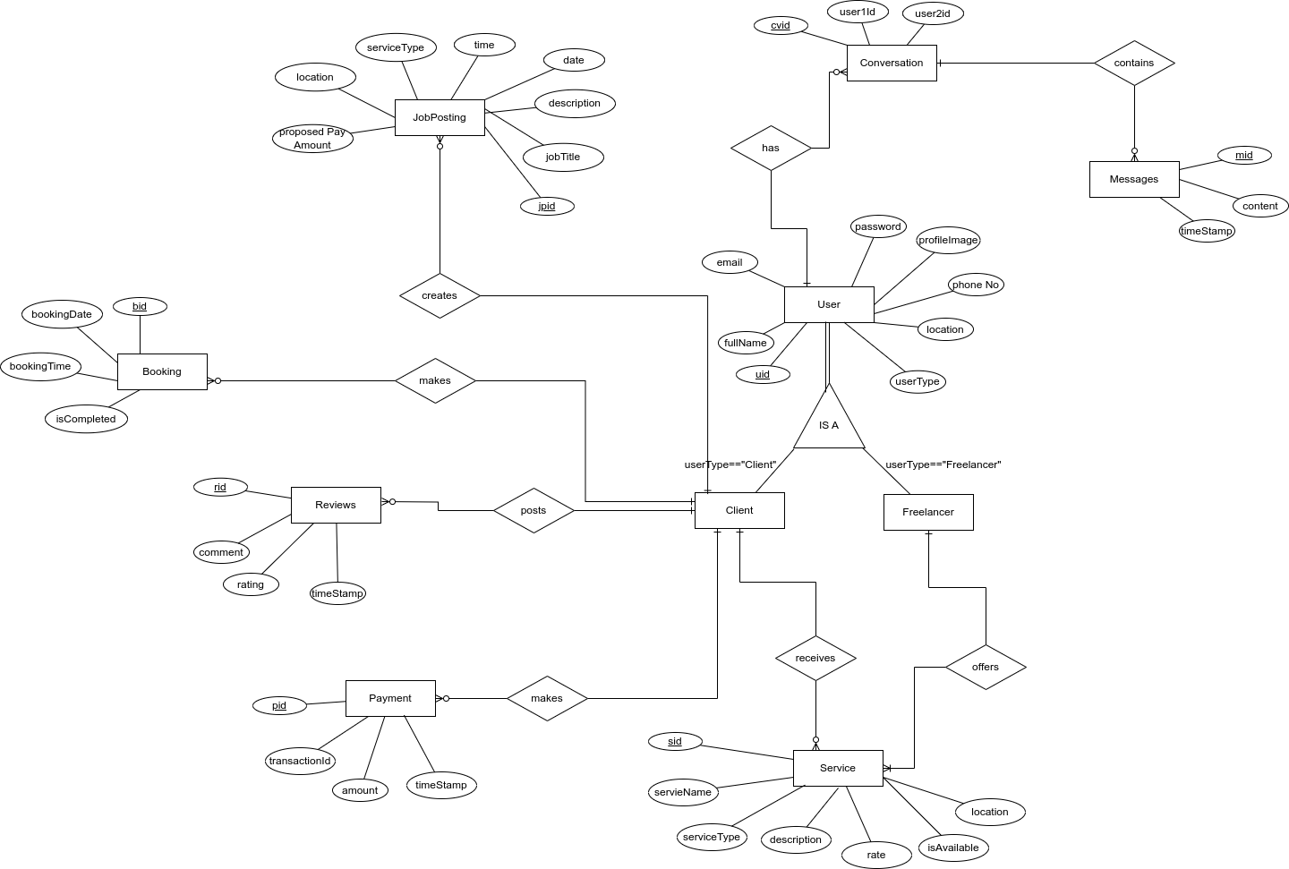
ER DIAGRAM
A Mid-Term Presentation by Team APParatus
8

Slide 10
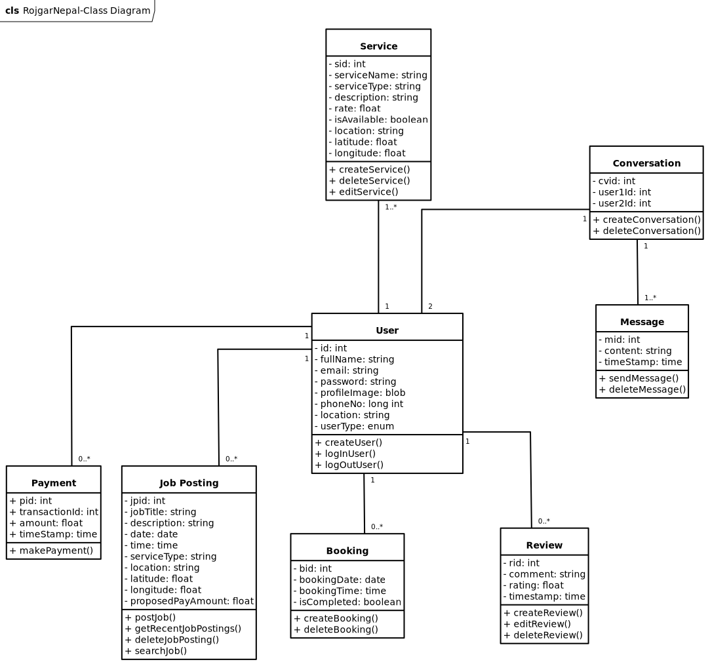
CLASS DIAGRAM
A Mid-Term Presentation by Team APParatus
9

Slide 11
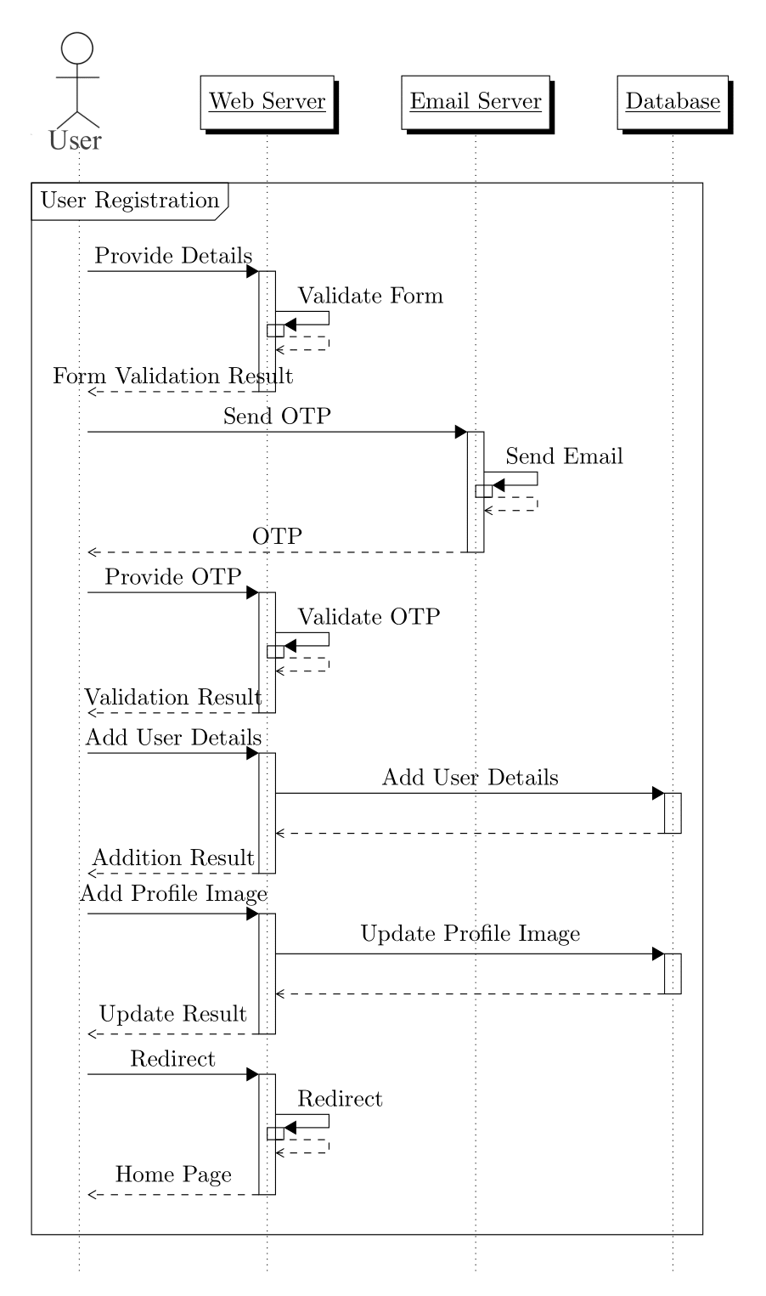
SEQUENCE DIAGRAM
Fig: Sequence Diagram for User Registration
A Mid-Term Presentation by Team APParatus
10

Slide 12
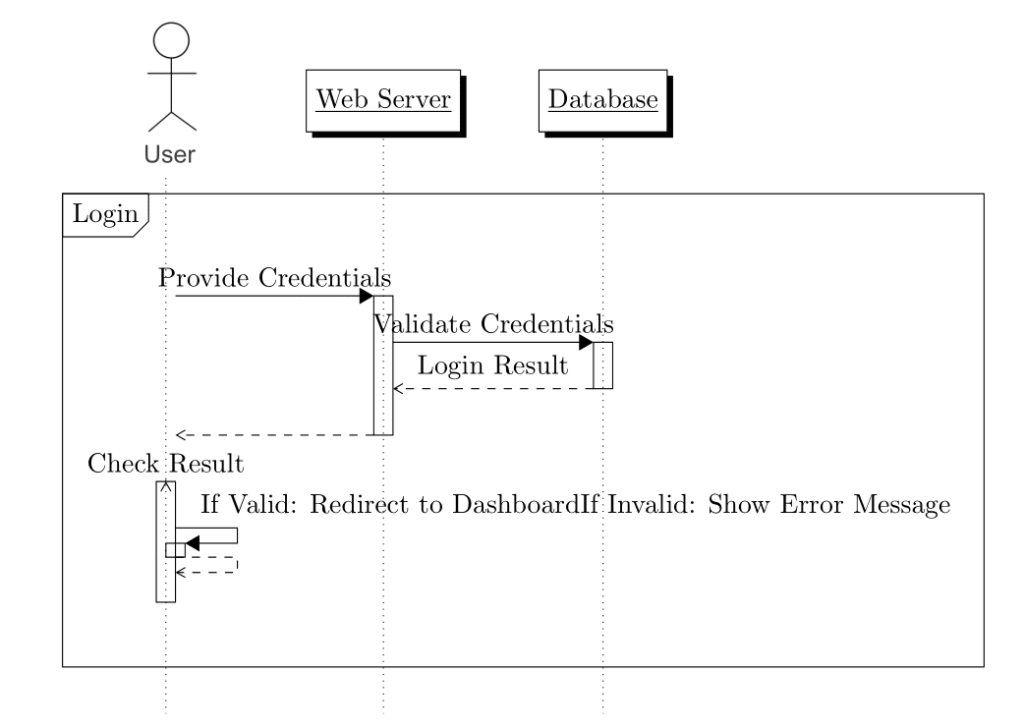
..
Fig: Sequence Diagram for User Login
A Mid-Term Presentation by Team APParatus
11

Slide 13
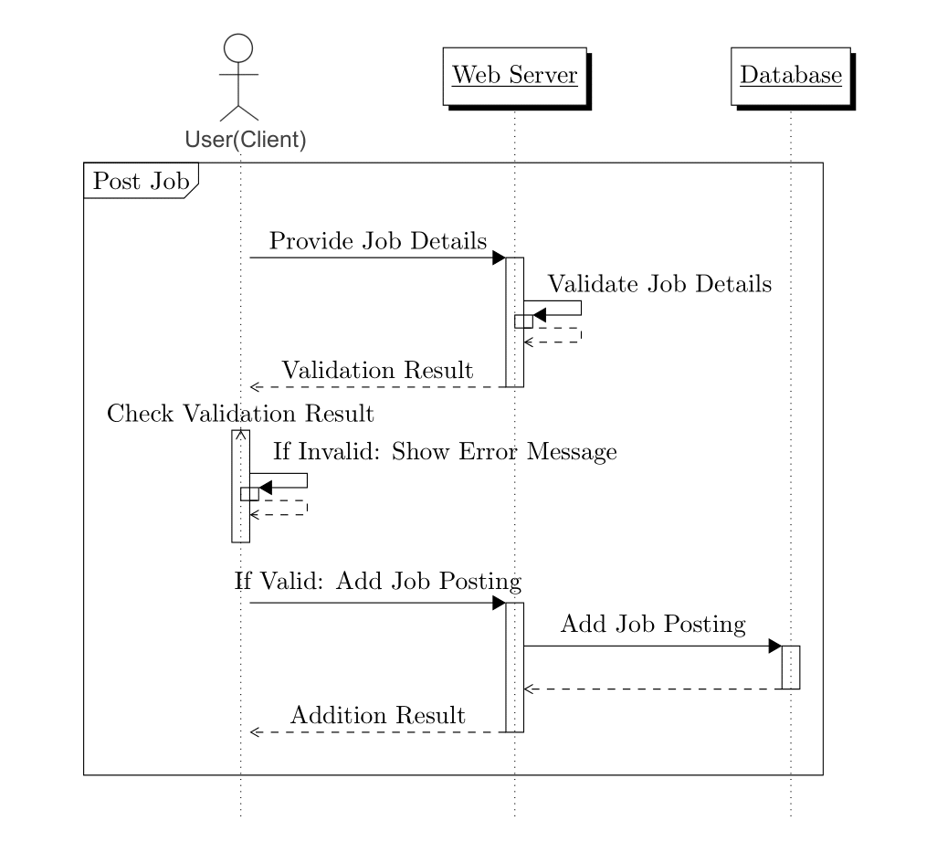
..
Fig: Sequence Diagram for Posting a Job
A Mid-Term Presentation by Team APParatus
12

Slide 14
TASKS DONE SO FAR
User Authentication and Authorization.
Verification of user's email by sending OTP.
Addition of Service by Freelancers.
Posting of Jobs.
Integration of Interactive Map.
Client and Freelancer’s Dashboard.
A Mid-Term Presentation by Team APParatus
13

Slide 15
TASKS TO DO
Integration of Chat System.
Integration of Online Payment Gateway.
Freelancer Booking System.
Recommendation System.
Reviews and Rating.
A Mid-Term Presentation by Team APParatus
14

Slide 16
TECHNICAL DESCRIPTION
TECHNOLOGY | PURPOSE
HTML | Structure of web pages
ReactJS | Frontend development
Node.js | Backend development
Express.js | Web application framework
Python and Flask | Recommendation system
MySQL | Database management
A Mid-Term Presentation by Team APParatus
15

Slide 17
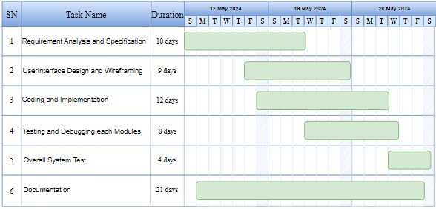
GANTT CHART
FIG: INCREMENT I
A Mid-Term Presentation by Team APParatus
16

Slide 18
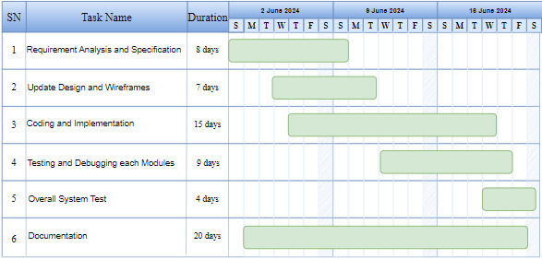
..
FIG: INCREMENT II
A Mid-Term Presentation by Team APParatus
17

Slide 19
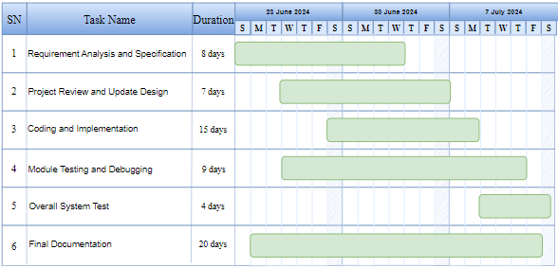
...
FIG: INCREMENT III
A Mid-Term Presentation by Team APParatus
18

Slide 20
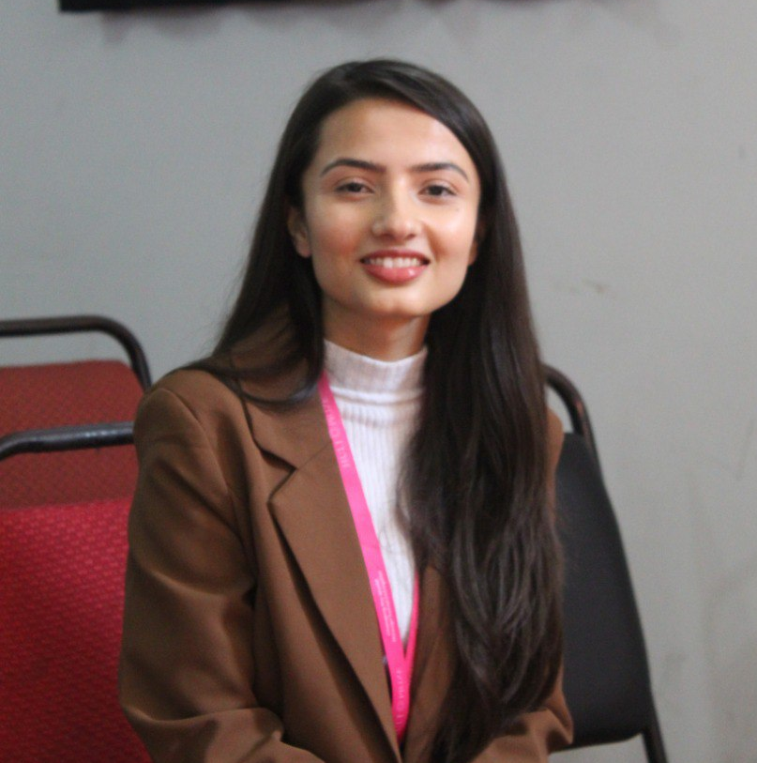
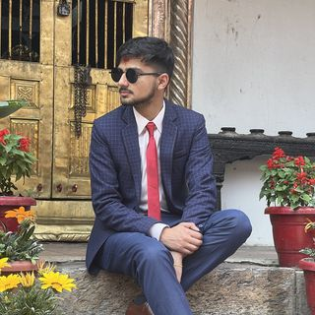

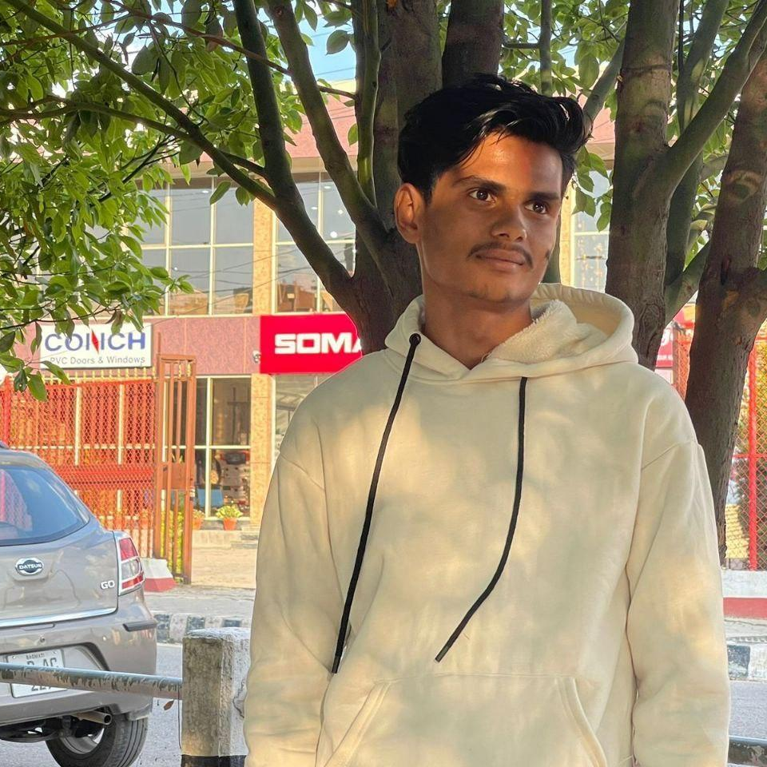
TEAM APParatus:
Abhinab Khanal
Raaz Gupta
Sandesh Khatiwada
Aayusha Regmi
Front-end Development,
UI/UX,
Documentation
Recommendation System, Front-end Development,
Documentation
Front-end Development, API Integration
Documentation
Backend Development,
API and Libraries Integration,
Documentation

Slide 21
THANK YOU !

